Slide 1

Adaptive Navigation of Multi-Robot Systems in Vector Fields
Christopher Waight
Santa Clara University
Mechanical Engineering Department
May 17, 2024
Notes:
Kyra rini
Kitts Lee
Marks Neumann

Slide 2
Agenda
Introduction
Problem Statement
Literature Review
Methodology
Preliminary Results
Expected Outcomes
Timeline
Implication of Findings
Summary
Question and Answers

Slide 3
Introduction Problem Statement Literature Review Methodology Preliminary Results Expected Outcomes Timeline Implication of Findings Summary Question and Answers
Robots, Multirobot systems, and Adaptive Navigation
Scalar Field Features
Scalar Field Primitives

Slide 4
Introduction
Robotics
Autonomous (Adaptive)
Single Robot Systems
Multi-Robot Systems
Adversarial
Collaborative
Human in the loop
Human Controlled
Formation Control
Task Execution
Navigation
Scalar Fields
Vector Fields
Autonomous (Conventional)
Independent
Memory Based
Memory Free
Adaptive Navigation is the process of altering a vehicles’ pose and trajectory in response to real time measurements.
Multirobot Systems have advantages over single robot systems including:
Expanded Coverage
Redundancy
Information Sharing
Memoryless adaptive navigation methods are also known as reactive control primitives.
Notes:
What is a control primitive?
Reactive
Instantaneous
Proven Results in scalar field MRS Navigation
Pro: low compute, quick response
Cons: Vulnerable to noise and local extrema

Slide 5
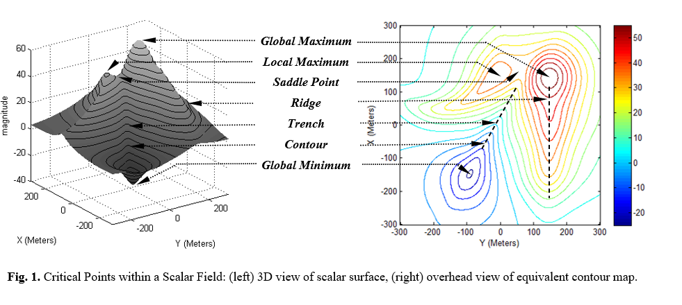
Multirobot Scalar Field Adaptive Navigation
Scalar Feature | Application Examples
Maximum | Source of pollution, radiation, gas, emission
Minimum | Quiet/safe spot, anoxic point
Contour | Safety perimeter, service threshold
Ridge / Plume | Path to impact area or optimal service
Trench | Path of max attenuation or min exposure
Saddle Point | Low exposure (energy) path btw max’s (min’s)
Front | Dramatic change that can stimulate activity
Notes:
Insert success slides here showing MR AN

Slide 6

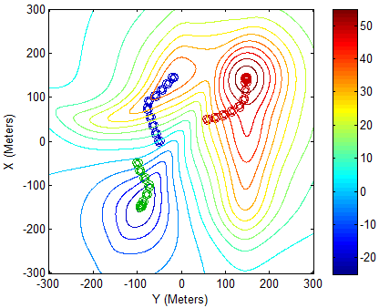
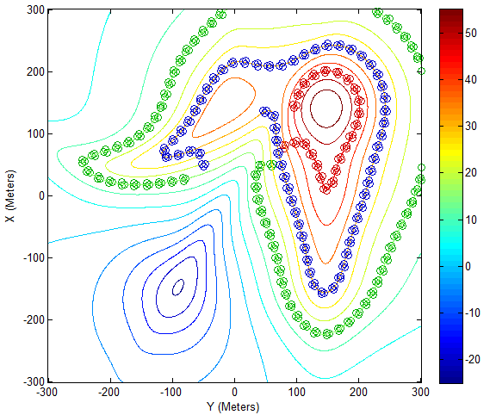
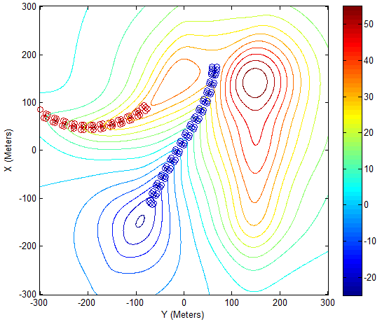
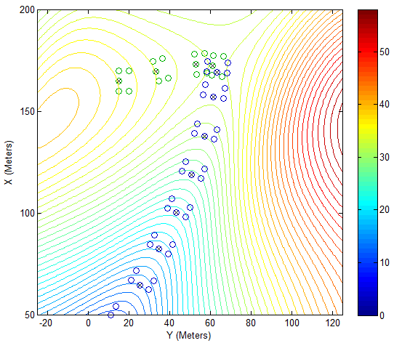
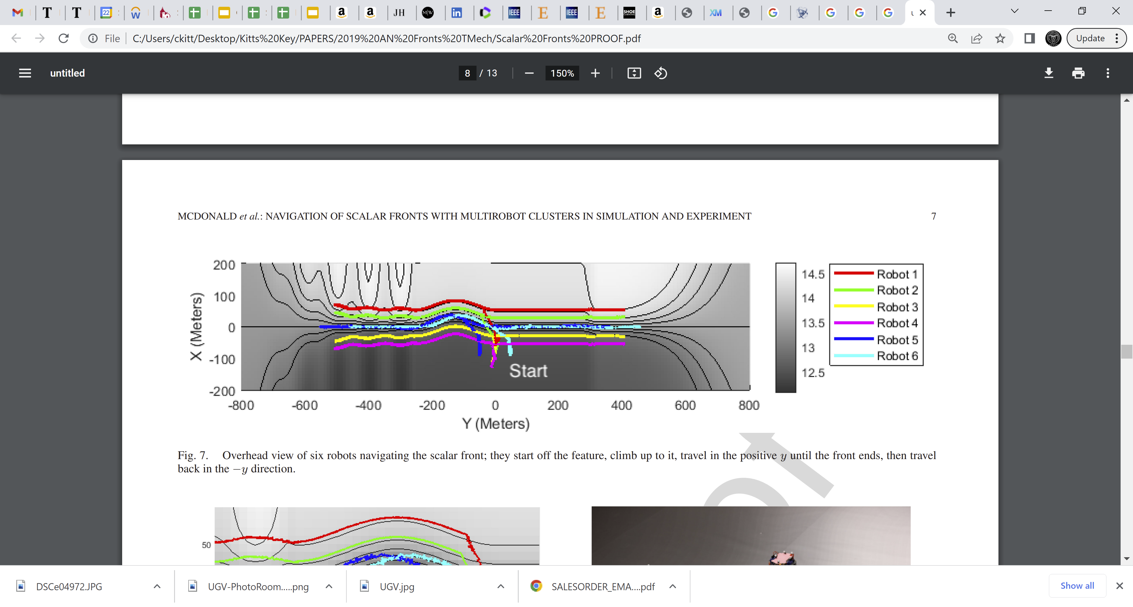
Robot Clusters - Simulations
Extrema Finding Contour Following Ridge/Trench Following
Saddle Point Finding Front Characterization

Slide 7
Introduction Problem Statement Literature Review Methodology Preliminary Results Expected Outcomes Timeline Implication of Findings Summary Question and Answers
Problem Statement
Motivation
Challenges

Slide 8
Can we design and analyze adaptive navigation primitives for multirobot systems to maneuver through complex and dynamic vector fields to specified regions and trajectories interest?

Slide 9
Can we design and analyze adaptive navigation methods for multirobot systems to maneuver through complex and dynamic vector fields to specified regions and trajectories interest?
Motivation to develop AN in Vector Fields :
Autonomous Navigation
Energy Efficiency
Obstacle Avoidance
Cross-Sectoral Applications
Challenges:
Computational Constraints
Time-Varying Environment
Imperfect Communication
Robustness to noise
Robot-Environment Interaction

Slide 10
Introduction Problem Statement Literature Review Methodology Preliminary Results Expected Outcomes Timeline Implication of Findings Summary Question and Answers
Artificial Vector Fields and Natural Vector Fields
Vector Fields via Superposition
Simulation Tools
Indoor Test Beds
Potential Outdoor Test Beds

Slide 11
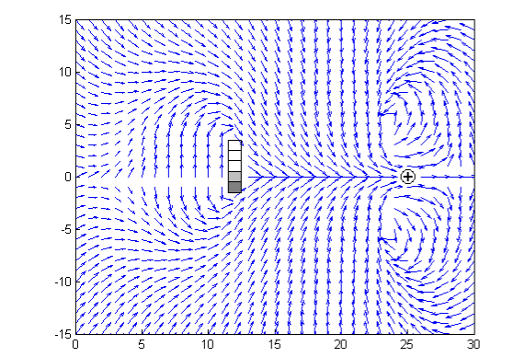
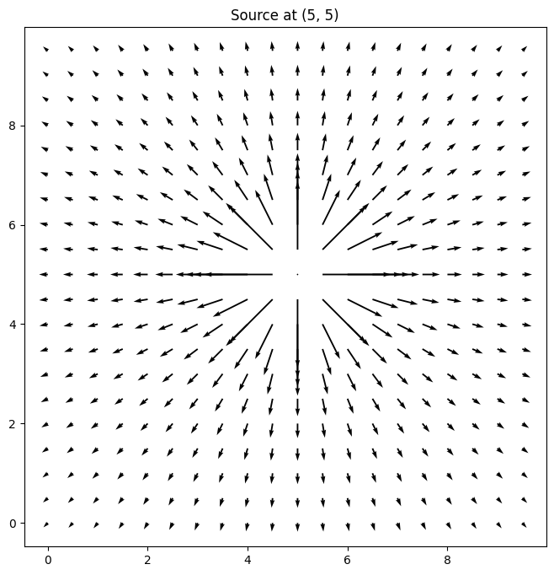
Adaptive Navigation in Vector Fields
Artificial Vector Fields
Robot systems create artificial vector fields and are used to guide individual robot navigation. [17],[18], [19], [21], [29]
Natural Vector Fields
Cooper, Ryan, et al. "Initial Study of Multirobot Adaptive Navigation for Exploring Environmental Vector Fields.” [13]
Vector Field Modelling
Test Bed
2x Control Primitives
Notes:
Potential Field == Artificial Vector Fields (work on this explanation) https://medium.com/@rymshasiddiqui/path-planning-using-potential-field-algorithm-a30ad12bdb08

Slide 12
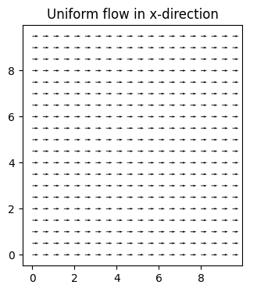
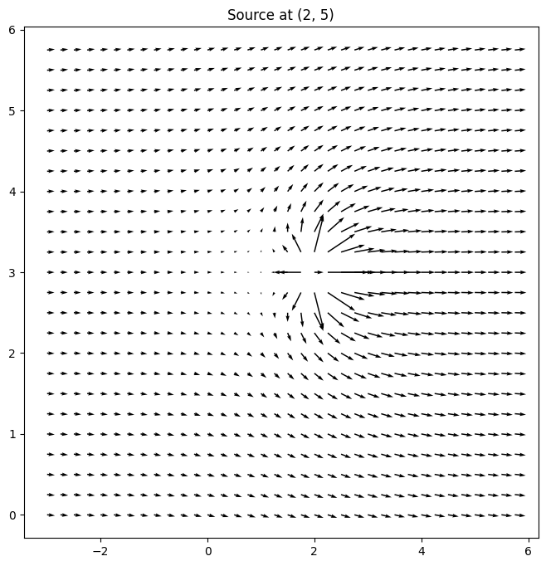
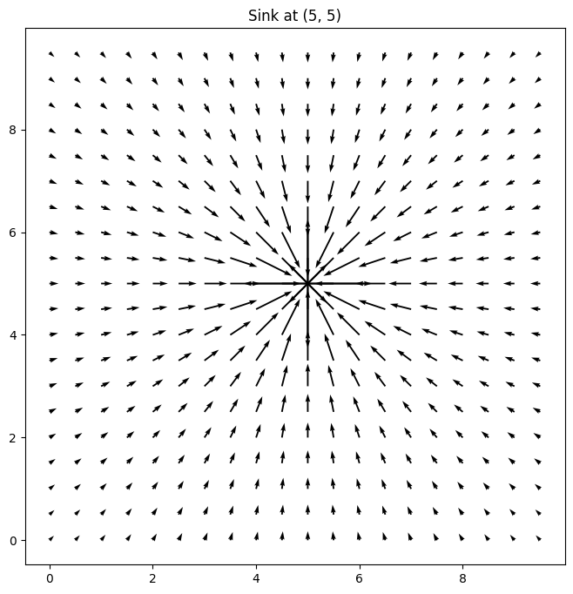
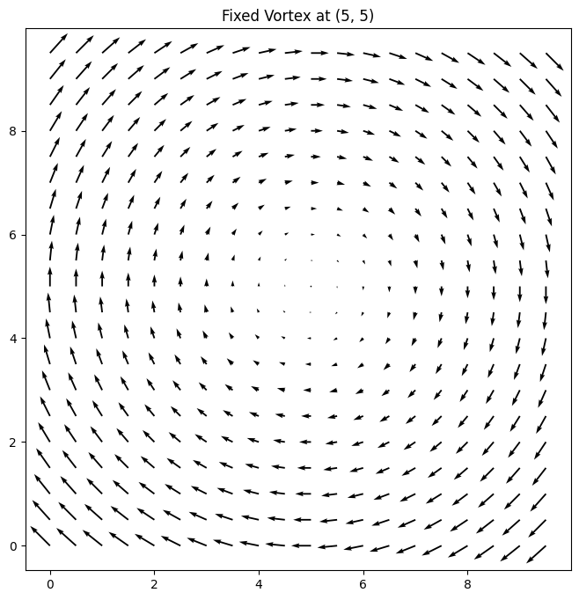
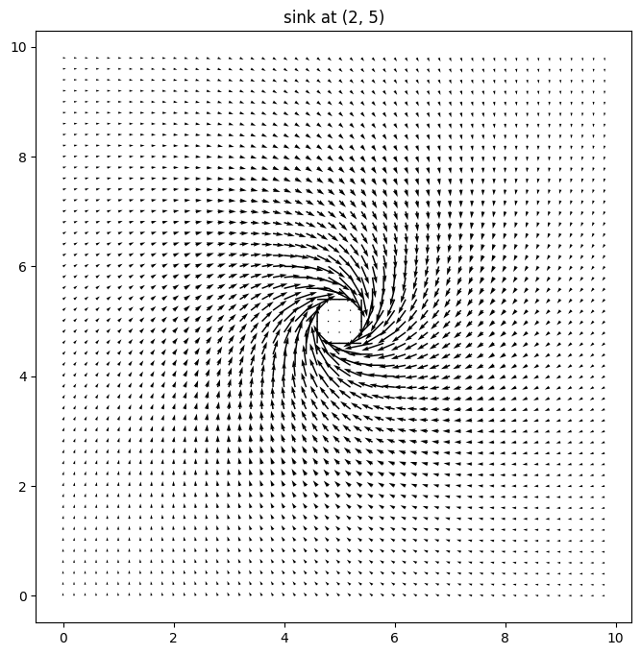
Vector Fields via Superposition of flows
meters
meters
meters
meters
meters
meters
meters
meters
meters
meters
meters
meters

Slide 13
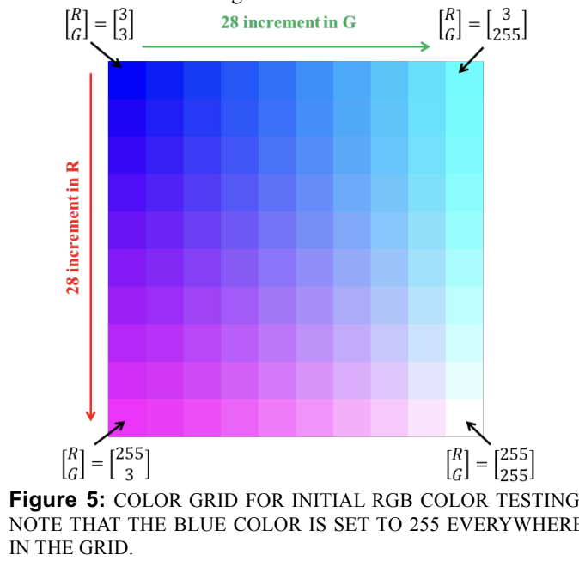
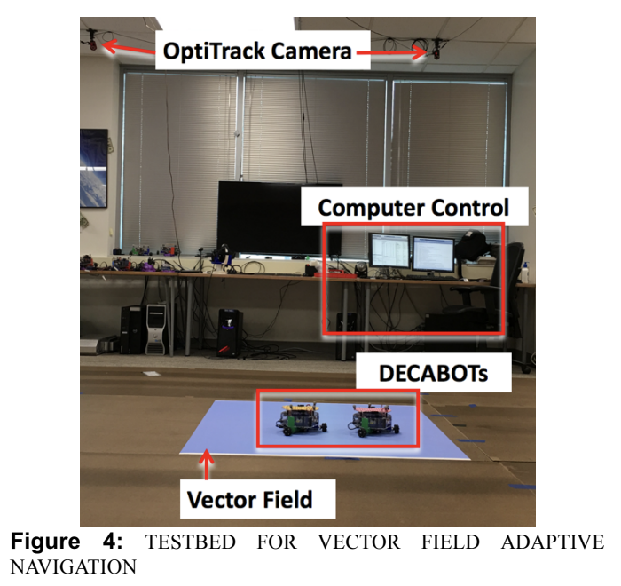
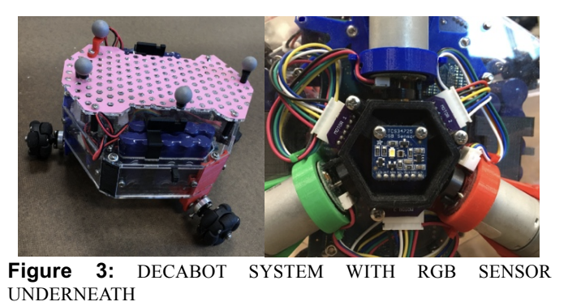
Indoor Test Bed
Omnibots
RGB Sensor
Centralized computation
TCP/IP
RGB color plots
OptiTrack provides visual feedback

Slide 14
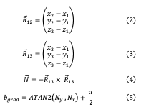
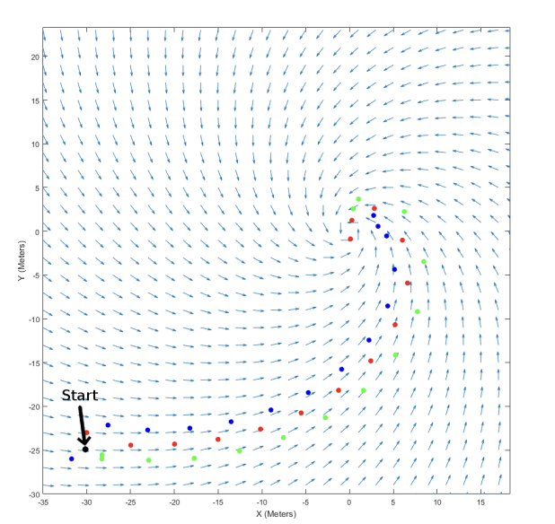
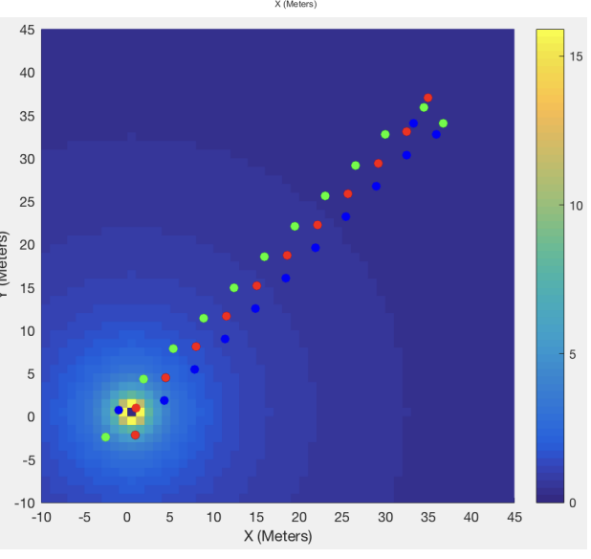

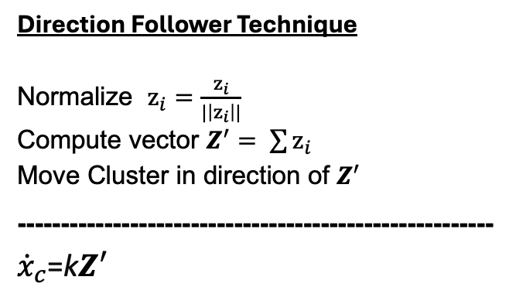
Initial Control Primitives
Direction Follower Technique
Normalize $z_{i}=\frac{z_{i}}{|\left|z_{i}\right||}$ Compute vector $Z^{′}= \sum{z_{i}}$ Move Cluster in direction of $Z^{′}$
-------------------------------------------------------${\dot{x}}_{c}$=k$Z^{′}$
Vector 2 Scalar Technique
z_{i} = || $\overset{⃑}{z_{i}}$|| = magnitude of vector reading for robot (i) ${\dot{x}}_{c}$ = Velocity of cluster frame
--------------------------------------------------------- ${\dot{x}}_{c}$=k $b_{grad}$
meters
meters

Slide 15
Open Questions
Can we design and analyze adaptive navigation methods for multirobot systems to maneuver through complex and dynamic vector fields to specified regions and trajectories interest?
More information? More features?
Stability? Robustness?
Scalability? Shape and performance?
More robots? Imperfect communication between robots?
Discrete sampling?
3D?

Slide 16
Introduction Problem Statement Literature Review Methodology Preliminary Results Expected Outcomes Timeline Implication of Findings Summary Question and Answers
Cluster Space Control Architecture
Control Block Diagram
Simulation Tools
Indoor Test Beds
Potential Outdoor Test Beds

Slide 17
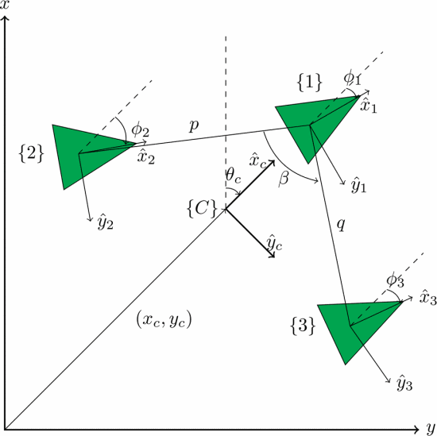
Cluster Space Control Architecture
Cluster Control Architecture
Perfect Communication
Randomized cluster variables

Slide 18
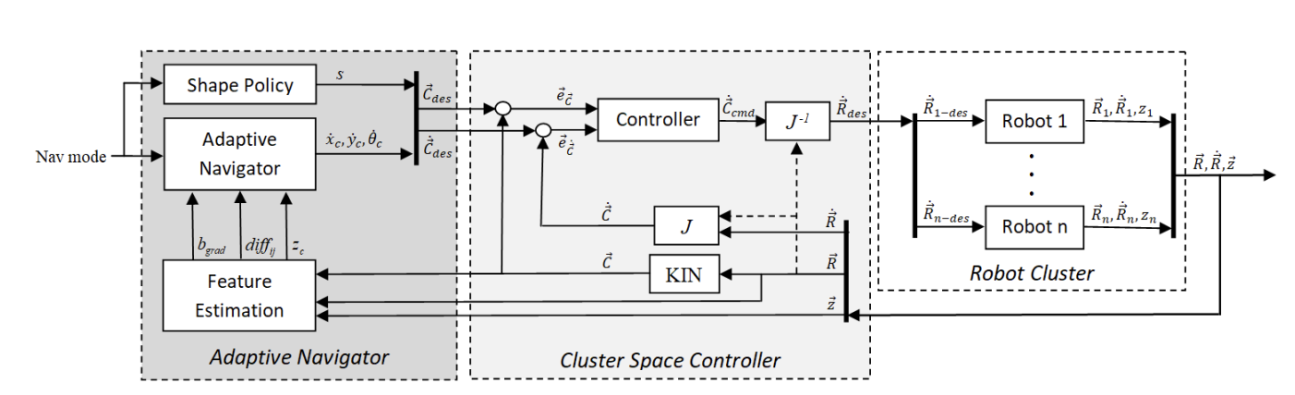
Control Block Diagram

Slide 19
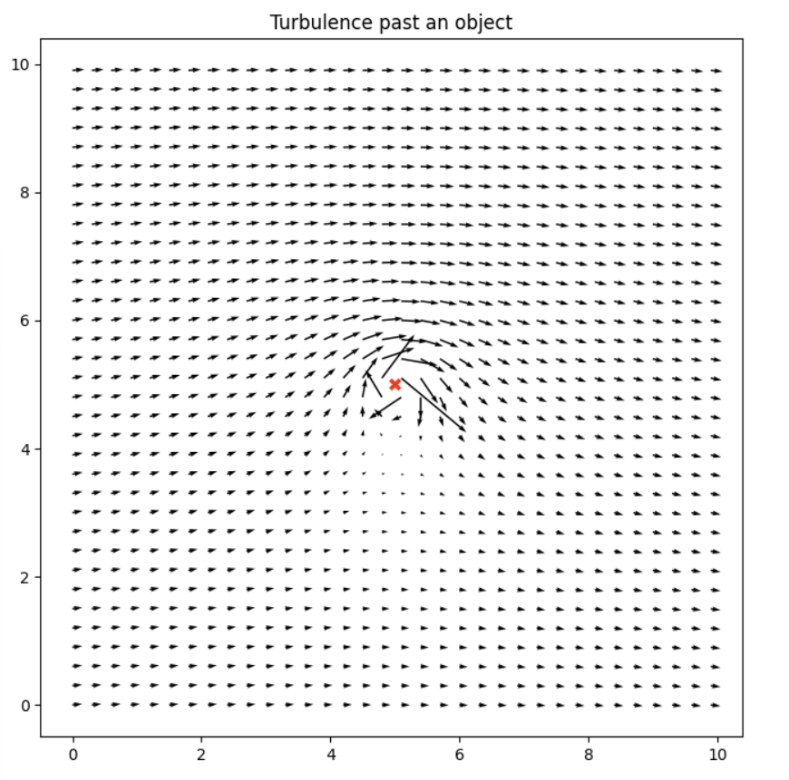
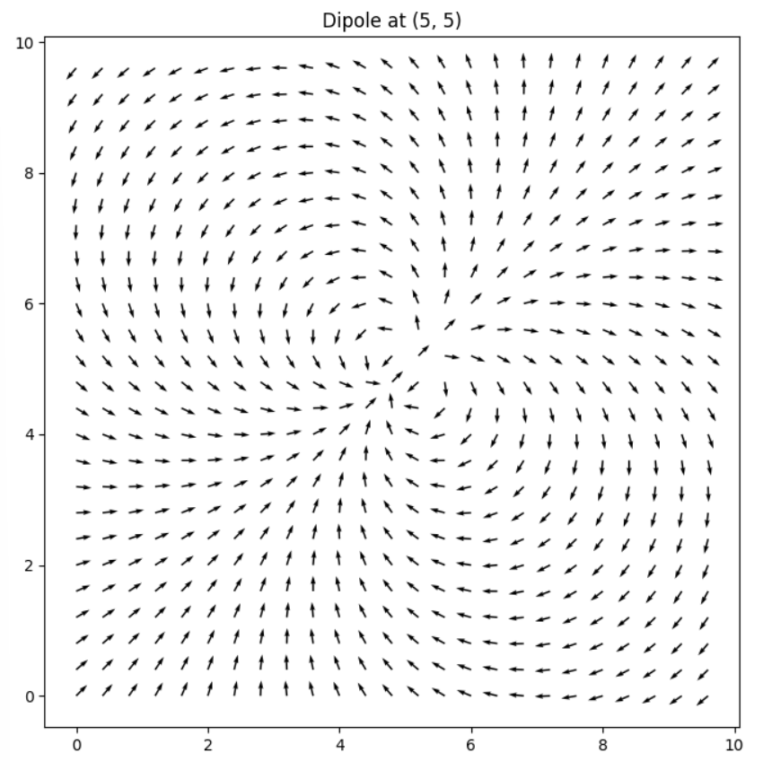
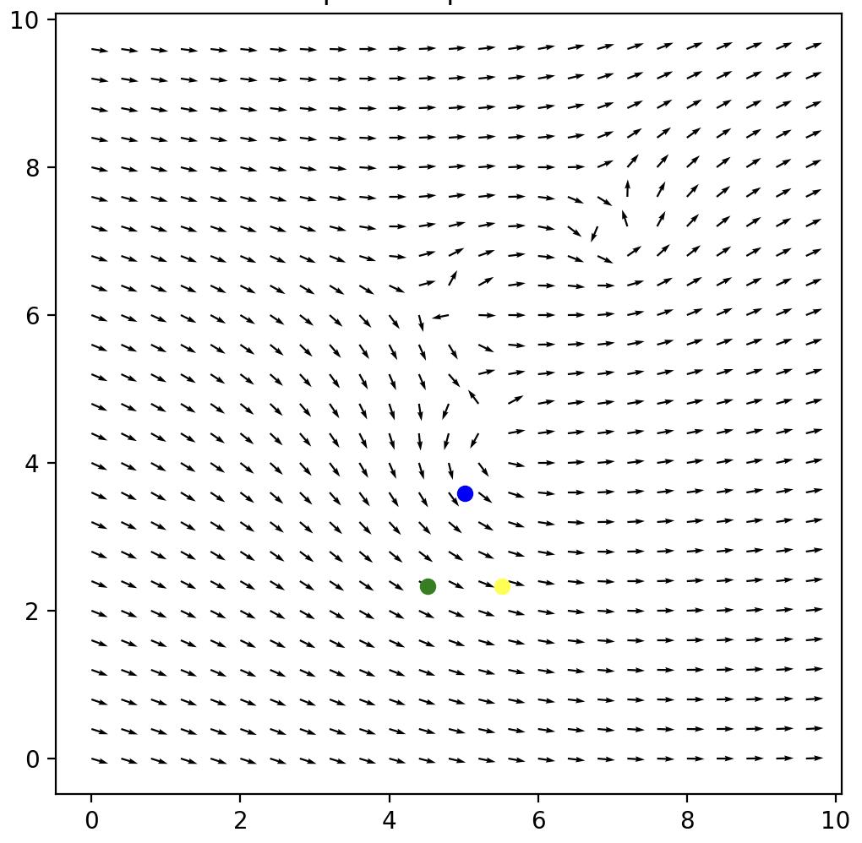
Simulation
Python 3.9 w/ standard libraries (numpy, matplotlib)
Superpositions of curl free and divergence free components.
Robots are Point masses with first order dynamics
meters
meters
meters
meters

Slide 20
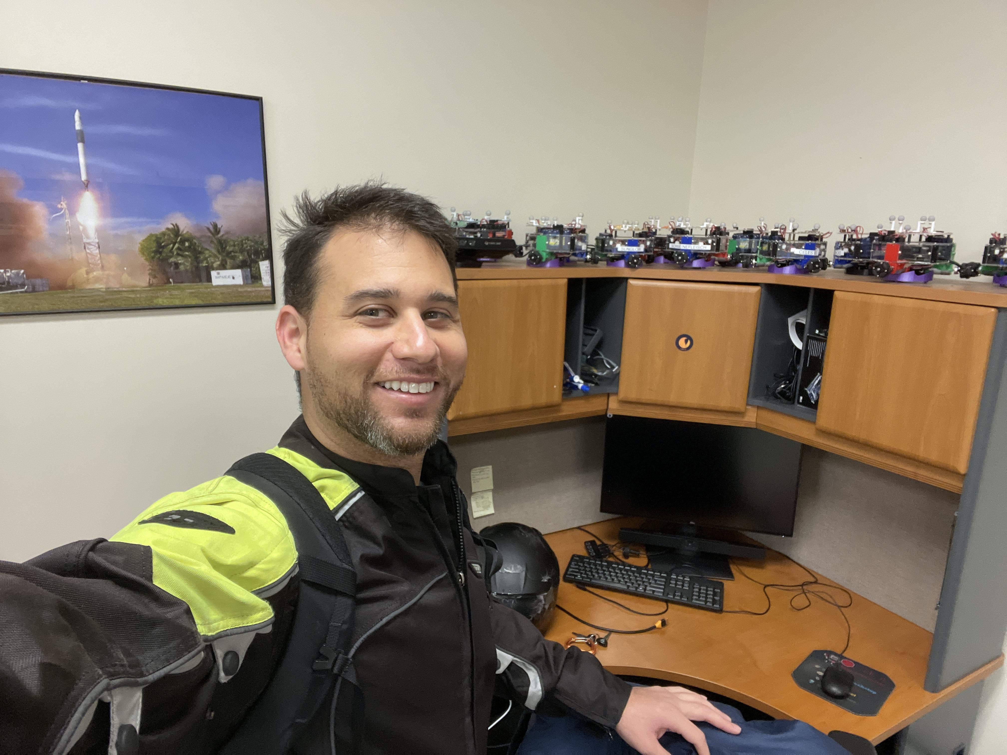
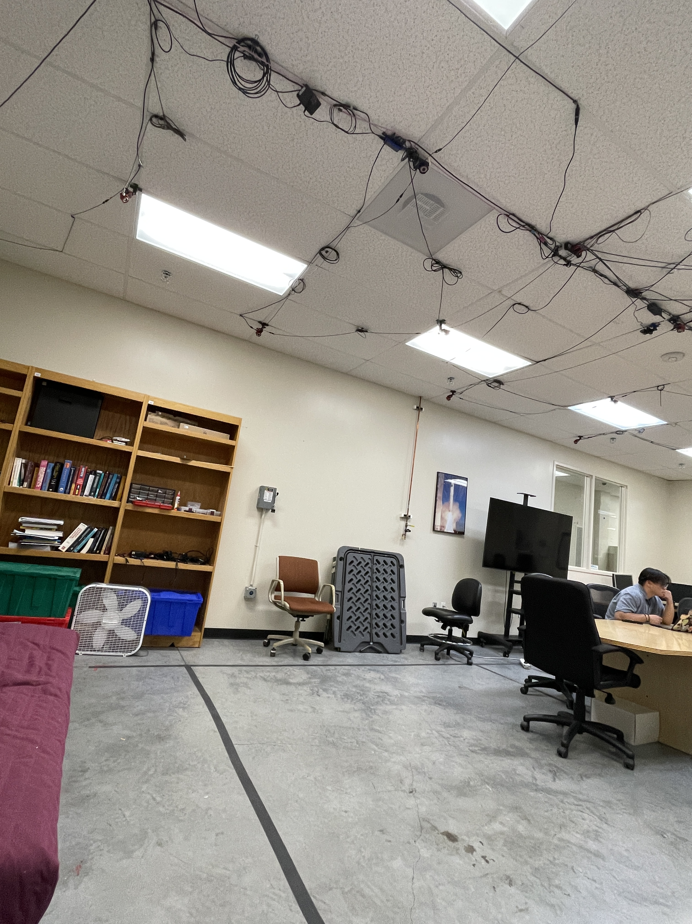
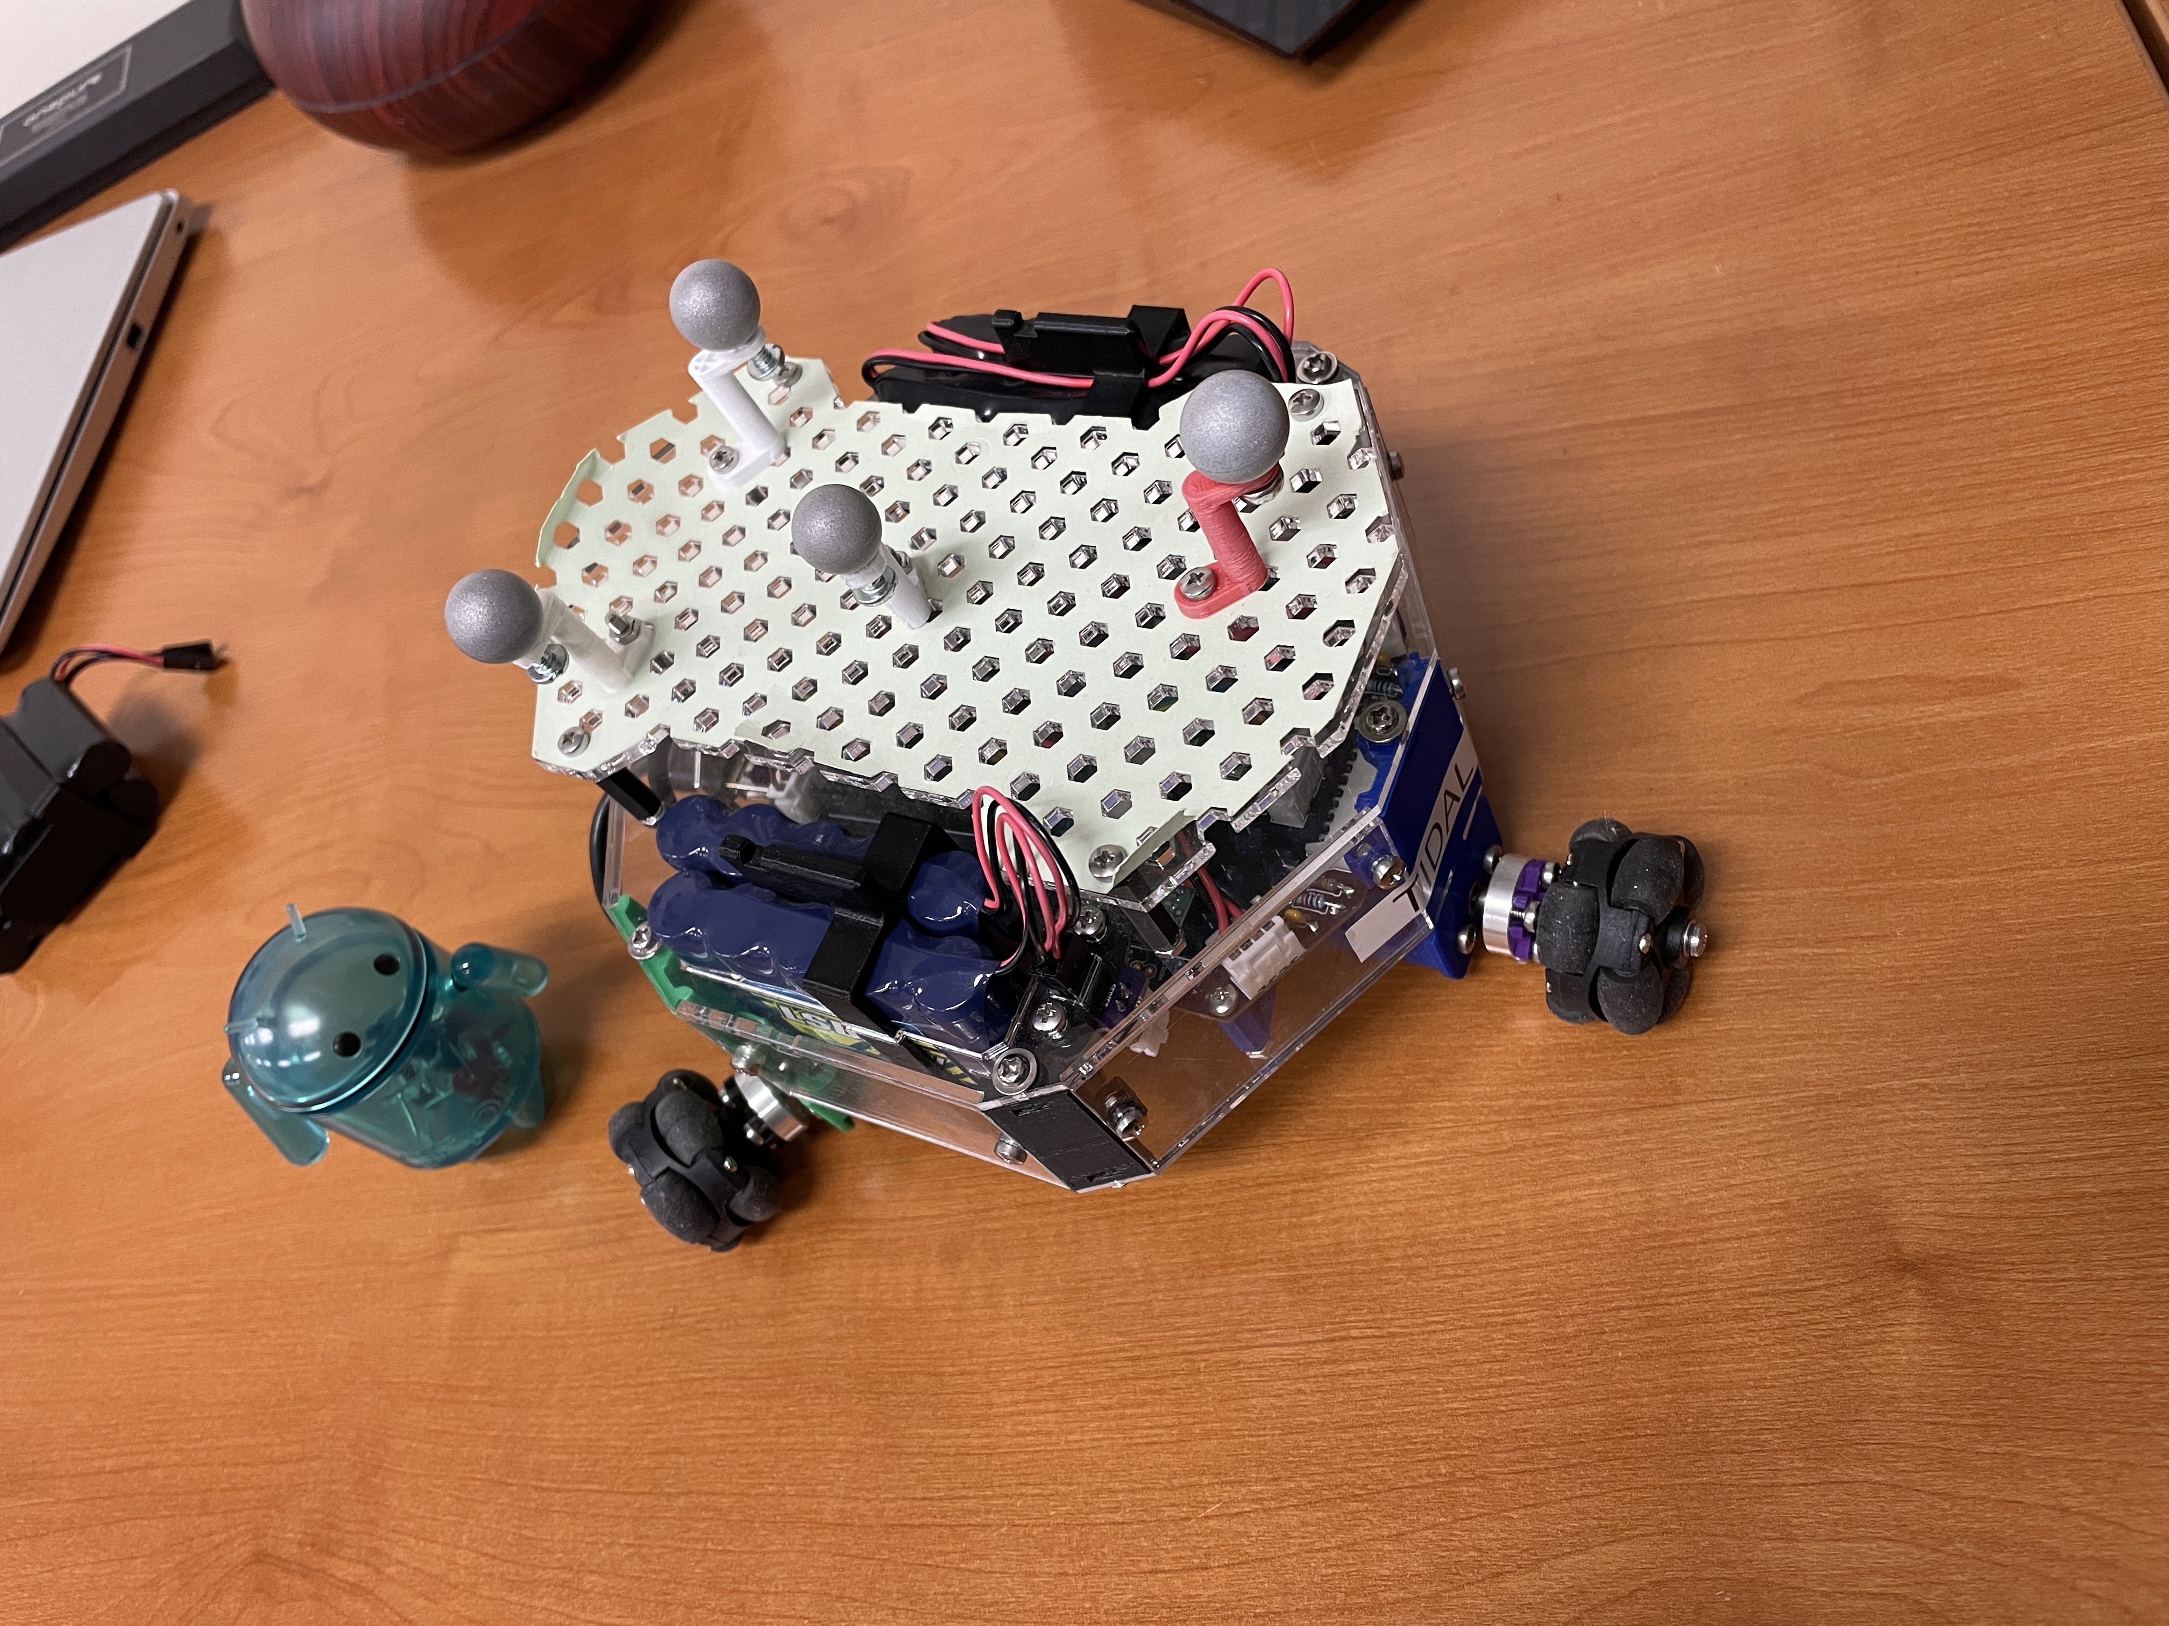
Test Bed

Slide 21
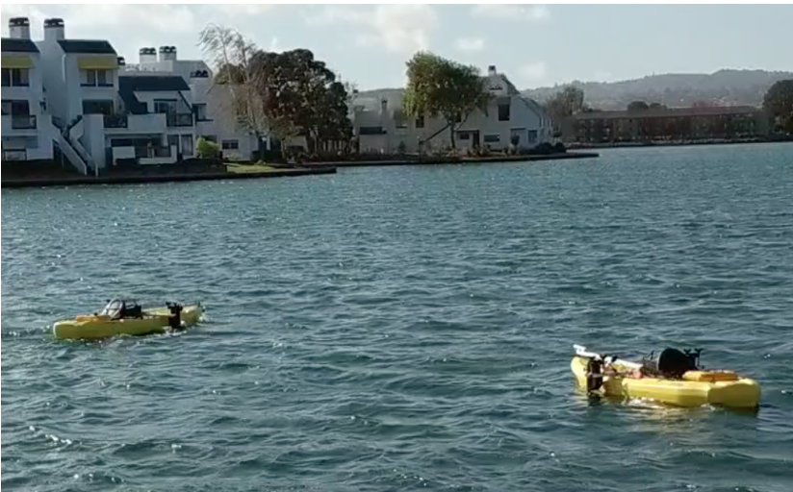
Outdoor Tests
Kayaks at Elkhorn Slough

Slide 22
Introduction Problem Statement Literature Review Methodology Preliminary Results Expected Outcomes Timeline Implication of Findings Summary Question and Answers
Areas of Interest Identified
Using Existing Primitive to find Stagnation Point
New Primitive to traverse Separatrix

Slide 23
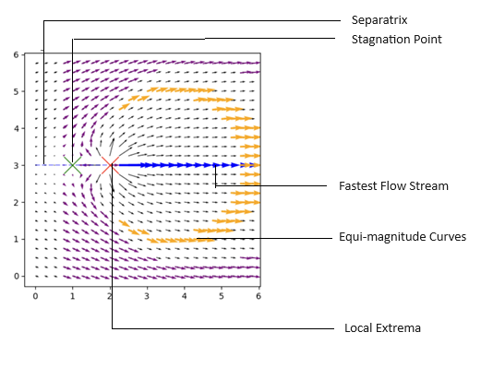
Regions of Interest
Region of Interest | How to Model | Importance
Extrema points | Sinks , Sources , Dipoles Rankine Vortex , Fixed Vortex, Free Vortex Sink + Vortex, Source + Vortex, Spring in Stream Opposing Vortices , Corotating Vortices | Location of a spring in a stream Source of magnetic pole Centre of gravity
Equimagnitude Contours | Sinks, Sources , Dipoles Rankine Vortex , Fixed Vortex Free Vortex, Sink + Vortex, Source + Vortex Spring in Stream, Opposing Vortices, Corotating Vortices | Staying within safe operating conditions
Fastest Flow Stream | Corotating Vortices, Superimposed Linear Streams, Spring in Stream Dipole, Vortex in Stream Opposing Vortices, Rankine Vortex | Locate wall of hurricane Fastest Tailwinds Fastest flow for fish or debris
Separatrix | Dipole , Vortex in stream Opposing Vortices, Opposing Streams, Spring in Stream, Corotating Vortices | Path that delineates bifurcating trajectories
Stagnation Point | Spring in Stream, Opposing Vortices Vortex in Stream, Opposing Streams Superimposed Linear Streams | Tracking Heat Waves
Transition Flow | Superposition of flows in sub-areas | Moderate Travel zone

Slide 24
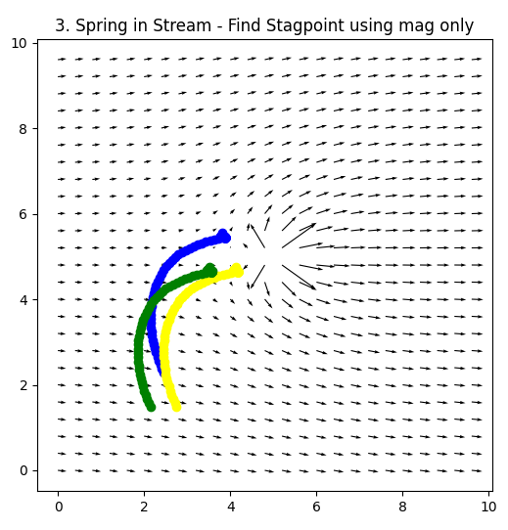
Navigation to Stagnation Point
meters
meters
Notes:
Add in algorithm.

Slide 25
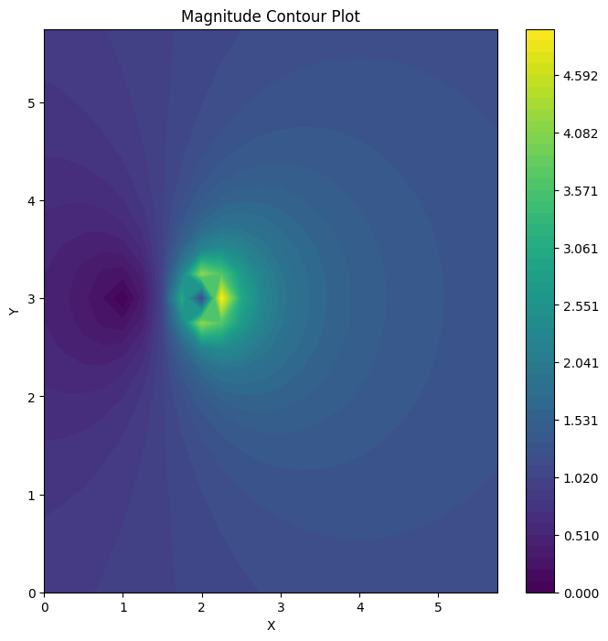
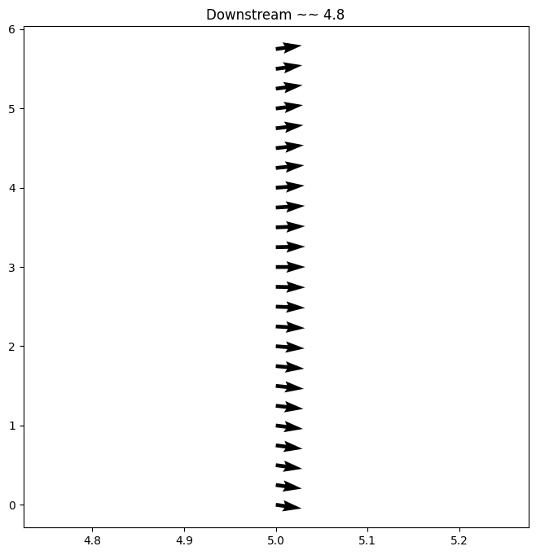
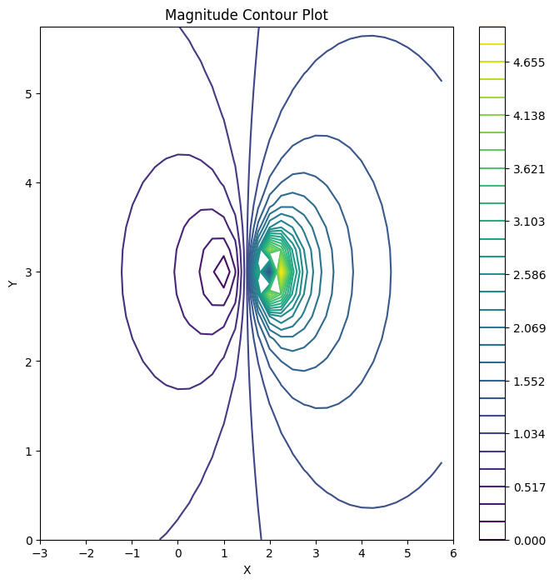
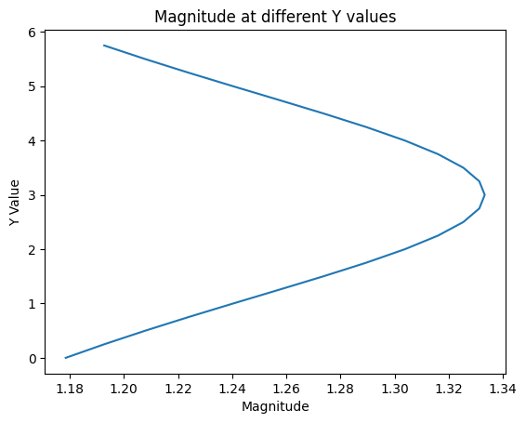
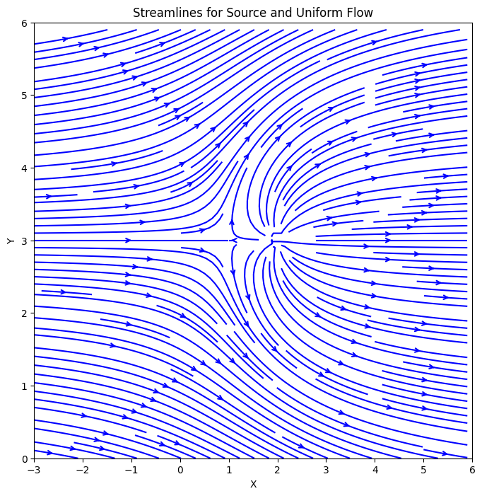
Stagnation point
Notes:
A parabola is the limit curve of a pencil of ellipses with a common vertex and one common focus, as the other focus is moved to infinity to the right, and also the limit curve of a pencil of hyperbolas with a common vertex and one common focus, as the other focus is moved to infinity to the left.
Units, a

Slide 26

Navigation to Stagnation Point
meters
z_{i} = || $\overset{⃑}{z_{i}}$|| = magnitude of vector reading for robot (i)
${\dot{x}}_{c}$ = Velocity of cluster frame
${\dot{x}}_{c}$=k $b_{grad}$
4
meters
Notes:
Add in algorithm.

Slide 27
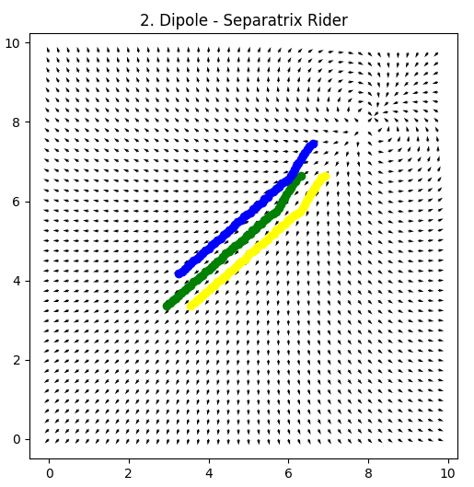
Separatrix Riding Technique
meters
meters

Slide 28
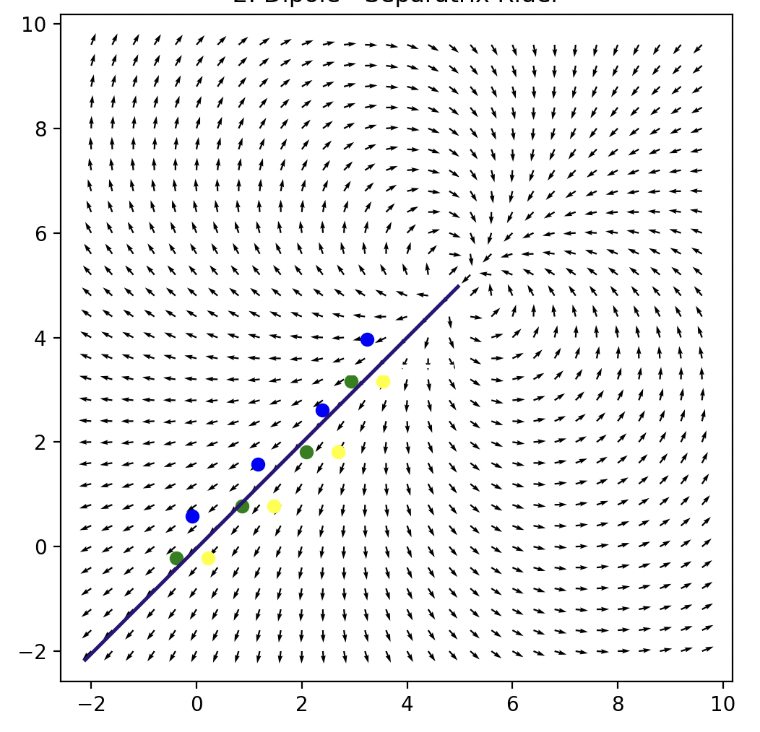
Separatrix Riding Technique
A separatrix is a boundary in phase space separating regions of different dynamics.
Nonlinear field → Nonlinear control What is the sliding mode? How do I chatter?

Slide 29
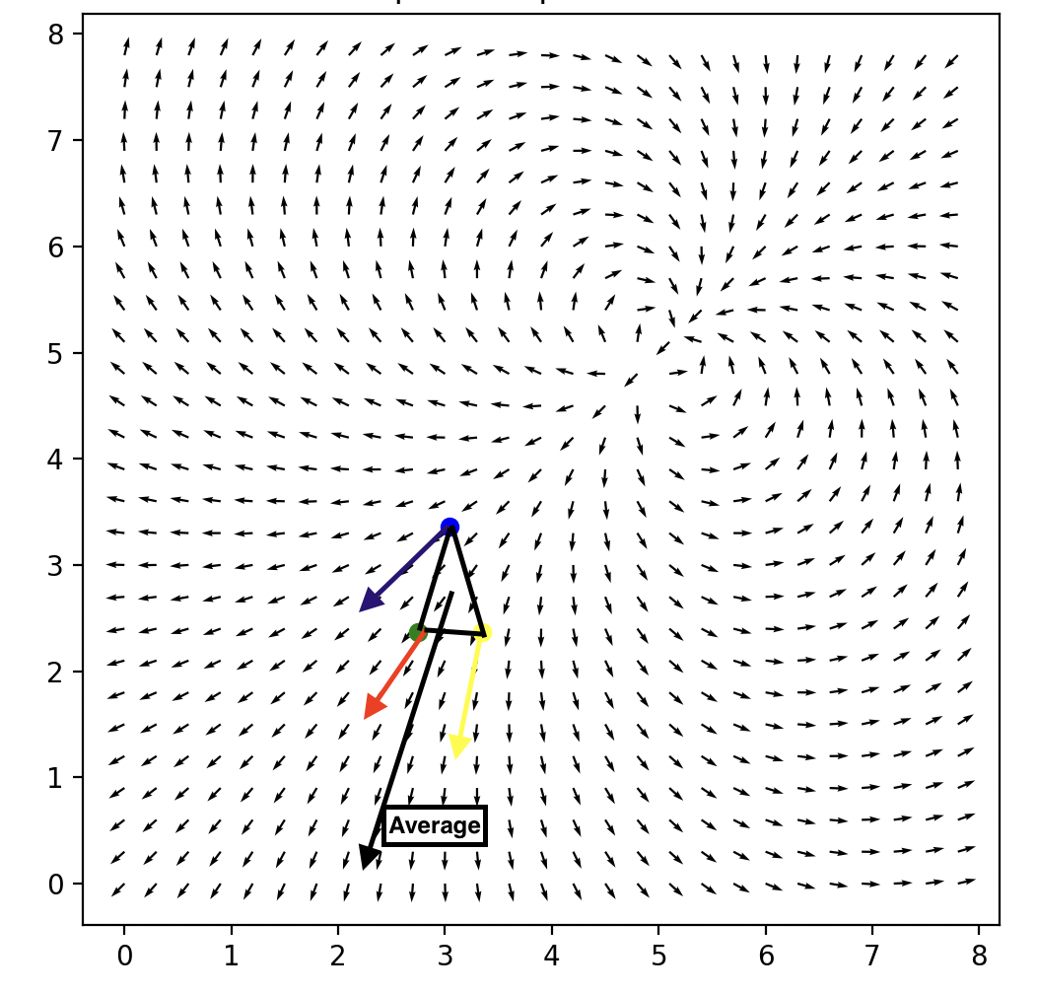
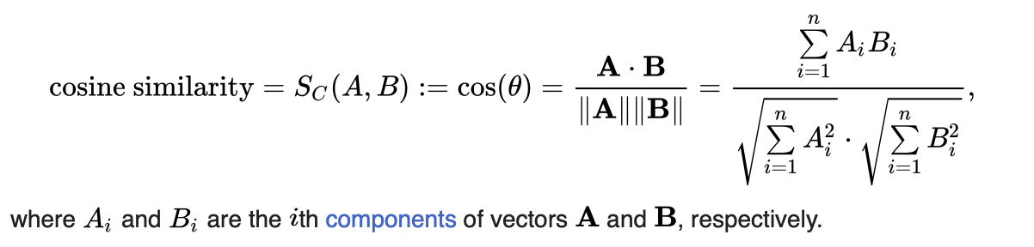
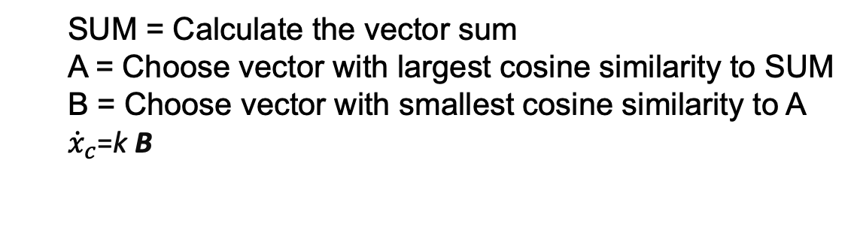
Separatrix Riding Technique
SUM = Calculate the vector sum
A = Choose vector with largest cosine similarity to SUM
B = Choose vector with smallest cosine similarity to A
${\dot{x}}_{c}$=k B
SUM

Slide 30
Separatrix Riding Technique
meters
meters

Slide 31
Introduction Problem Statement Literature Review Methodology Preliminary Results Expected Outcomes Timeline Implication of Findings Summary Question and Answers
Expected Results
Expected Challenges

Slide 32
Expected Results at Completion
An Adaptive Navigation of Multirobot Systems in Vector Field Simulation tool
Catalog of Vector Field Features of Interest
Design and Analysis of Vector Field Primitives
Experimental verification of 2D cases on indoor test bed
Completed Outdoor Experiment
Notes:
Stability (within certain bounds or in the sense of Lyapunov).
Performance as a function of robots.
Robustness to noise.
Performance as a function of shape.
Computational Scalability Analysis
Best Use Cases

Slide 33
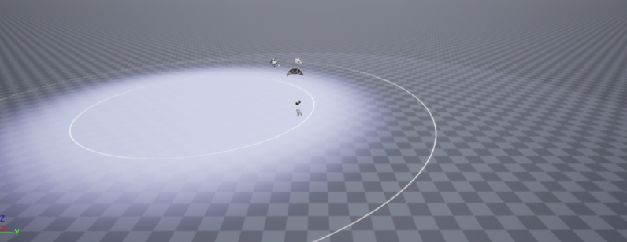
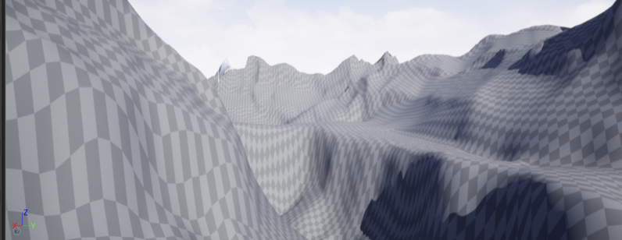
Expected Challenges and Mitigations
Imperfect communication → Decentralized controller.
Computation time → BigO Runtime Optimization
Robot Collison → A self collision avoidance routine
Degenerate Formations → Singularity avoidance techniques
Dynamic Environments → Temporal modelling
3D Visualizations – Unreal Engine?

Slide 34
Introduction Problem Statement Literature Review Methodology Preliminary Results Expected Outcomes Timeline Implication of Findings Summary Question and Answers

Slide 35
Next Steps
2024
May/June – Rebuild Simulation tools and baseline of indoor testing
July/Aug – Stability Analysis of current primitives
Sep/Oct – Performance Analysis with increasing number of robots
Nov/Dec – Indoor Testing
2025
Jan/Feb – Search for new primitives (2D and 3D)
Mar/April – Stability Analysis and Big O analysis
May - Indoor Testing
June/July – Plan, Design, Execute Outdoor Test
Aug / Sep - Decentralized control and discrete sampling Analysis
Oct – Indoor Testing
Nov – Thesis Writing and Defending
Dec – Hand off

Slide 36
Introduction Problem Statement Literature Review Methodology Preliminary Results Expected Outcomes Timeline Implications Summary Question and Answers

Slide 37
Implications of Findings / Potential Next Steps
Autonomous Navigation of Vector Fields.
Efficiencies in navigation and in search.
Incorporation into existing controllers.
Cross sectoral applications and multi-domain use cases:
Finding fastest flow for debris collection
Obstacle avoidance routines
Aerial Drones efficiencies with tailwinds

Slide 38
Introduction Problem Statement Literature Review Methodology Preliminary Results Expected Outcomes Timeline Implications Summary Question and Answers
Problem Statement
Importance
Recap of Current Efforts

Slide 39
Summary
Can we design and analyze adaptive navigation methods for multirobot systems to maneuver through complex and dynamic vector fields to specified regions and trajectories interest?
This research will extend the work of multirobot in vector fields by:
Creating a methodological way of modelling vector fields for multirobot research.
Creating a catalogue of regions of interest within vector fields.
Design and Analysis of control primitives for vector fields.
Demonstrate success off these primitives in simulation and on a physical test bed.
Findings can be implemented in existing controller architectures.
Findings are applicable on land, sea, sky, and space.

Slide 40
Thank you
Question and Answers

Slide 41
Appendix
References
Additional Slides

Slide 42
References
[1] Adamek, Thomas, Christopher A. Kitts, and Ignacio Mas. "Gradient-based cluster space navigation for autonomous surface vessels." IEEE/ASME Transactions on Mechatronics20.2 (2014): 506-518.
[2] C. A. Kitts and I. Mas, "Cluster Space Specification and Control of Mobile Multirobot Systems," in IEEE/ASME Transactions on Mechatronics, vol. 14, no. 2, pp. 207-218, April 2009, doi: 10.1109/TMECH.2009.2013943.
[3] I. Mas, S. Li, J. Acain, and C. A. Kitts, “Entrapment/escorting and patrolling missions in multi-robot cluster space control,” in Proc. IEEE/RSJ Int. Conf. Intell. Robots Syst., St. Louis, MO, USA, Oct. 2009, pp. 5855– 5861.
[4] M. Woolsey, C. A. Kitts and M. A. Neumann, "Gradient-based Adaptive Navigation of Multiple Diving Autonomous Surface Vehicles," OCEANS 2022, Hampton Roads, Hampton Roads, VA, USA, 2022, pp. 1-8, doi: 10.1109/OCEANS47191.2022.9977006.
[5] C. A. Kitts and M. Egerstedt, “Design, control, and applications of real world multirobot systems [from the Guest Editors],” IEEE Robot. Autom. Mag., vol. 15, no. 1, p. 8, Mar. 2008.
[6] Lee, Robert K., et al. "3-d adaptive navigation: Multirobot formation control for seeking and tracking of a moving source." 2020 IEEE Aerospace Conference. IEEE, 2020.
[7] S. T. Hart and C. A. Kitts, "Unifying Control Architecture for Reactive Particle Swarms," in IEEE/ASME Transactions on Mechatronics, vol. 28, no. 2, pp. 873-883, April 2023, doi: 10.1109/TMECH.2022.3211155.
[8] Hart, Shae T., Jake Kamenetsky, and Christopher A. Kitts. "Dynamic Elliptical Shaping Control for Swarm Robots." IEEE Access 11 (2023): 17454-17470
[9] McDonald, Robert T., et al. "Navigation of scalar fronts with multirobot clusters in simulation and experiment." IEEE Systems Journal 14.3 (2020): 3755-3766.
[10] C. A. Kitts, R. T. McDonald, and M. A. Neumann, “Adaptive navigation control primitives for multirobot clusters: Extrema finding, contour following, ridge/trench following, and saddle point station keeping,” IEEE Access, vol. 6, pp. 17 625–17 642, 2018.
[11] Trakas, Panagiotis S., Andreas Tantoulas, and Charalampos P. Bechlioulis. "Formation Control of Nonlinear Multi-Agent Systems with Nested Input Saturation." Applied Sciences 14.1 (2023): 213.
[12] Matveev, Alexey, et al. "Non-Gradient Based Tracking of Environmental Field Isolines in a Changing Medium by Dubins-Vehicle Type Robots." IEEE Transactions on Automatic Control (2023).
[13] Cooper, Ryan, et al. "Initial Study of Multirobot Adaptive Navigation for Exploring Environmental Vector Fields." 2019 IEEE Aerospace Conference. IEEE, 2019.
[14] Mas, Ignacio, and Christopher Kitts. "Quaternions and dual quaternions: Singularity-free multirobot formation control." Journal of Intelligent & Robotic Systems 87 (2017): 643-660.
[15] Wang, J., Guo, Y., Fahad, M., and Bingham, B., 2019, “Dynamic Plume Tracking by Cooperative Robots,” IEEE/ASME Transactions on Mechatronics, early access.
[16] Braquet, Martin, and Efstathios Bakolas. "Vector field-based collision avoidance for moving obstacles with time-varying elliptical shape." IFAC-PapersOnLine 55.37 (2022): 587-592.

Slide 43
References
[17] Liddy, Tommie, et al. "Obstacle avoidance using complex vector fields." Proc. of the 2008 Australasian Conference on Robotics and Automation, Canberra, Australia. 2008.
[18] Nelson, Derek R., et al. "Vector field path following for miniature air vehicles." IEEE Transactions on Robotics 23.3 (2007): 519-529.
[19] Hu, Bin-Bin, et al. "Spontaneous-Ordering Platoon Control for Multirobot Path Navigation Using Guiding Vector Fields." IEEE Transactions on Robotics (2023).
[20] Garg, Kunal, and Dimitra Panagou. "Finite-time estimation and control for multi-aircraft systems under wind and dynamic obstacles." Journal of Guidance, Control, and Dynamics 42.7 (2019): 1489-1505.
[21] Yao, Weijia, et al. "Singularity-free guiding vector field for robot navigation." IEEE Transactions on Robotics 37.4 (2021): 1206-1221.
[22] Rajabhandharaks, Danop, et al. "Indoor Testbed for Vector Field Multirobot Adaptive Navigation: Feasibility Study." International Design Engineering Technical Conferences and Computers and Information in Engineering Conference. Vol. 59292. American Society of Mecha nical Engineers, 2019.
[23] Matveev, Alexey, et al. "Gradient-free tracking of unsteady environmental level sets in dynamic environments by a nonholonomic robot." IFAC-PapersOnLine 53.2 (2020): 9256-9261.
[24] R. K. Lee, C. A. Kitts, M. A. Neumann and R. T. Mcdonald, "Multiple UAV Adaptive Navigation for Three-Dimensional Scalar Fields," in IEEE Access, vol. 9, pp. 122626-122654, 2021, doi: 10.1109/ACCESS.2021.3107854.
[25] Thangavelautham, Jekan, and Yinan Xu. "Co-Evolution of Multi-Robot Controllers and Task Cues for Off-World Open Pit Mining." arXiv preprint arXiv:2009.09149 (2020).
[26] Kalita, Himangshu, et al. "Guidance, navigation and control of multirobot systems in cooperative cliff climbing." arXiv preprint arXiv:1701.07553 (2017).
[27] Bychkov, I. V., A. A. Tolstikhin, and S. A. Ulyanov. "A lobster-inspired multi-robot control strategy for monitoring non-stationary concentration fields." Journal of Physics: Conference Series. Vol. 2099. No. 1. IOP Publishing, 2021.
[28] Li, Shuai, Ruofan Kong, and Yi Guo. "Cooperative distributed source seeking by multiple robots: Algorithms and experiments." IEEE/ASME Transactions on mechatronics 19.6 (2014): 1810-1820..
[29] Gonçalves, Vinicius Mariano, Ryan McLaughlin, and Guilherme AS Pereira. "Precise landing of autonomous aerial vehicles using vector fields." IEEE Robotics and Automation Letters 5.3 (2020): 4337-4344.
[30] Woolsey, Max, Michael A. Neumann, and Christopher A. Kitts. "Spiral Search Pattern for Scalable Assemblages of Uncrewed Surface Vehicles." OCEANS 2023-MTS/IEEE US Gulf Coast. IEEE, 2023.
[31] Hoy, Michael, Alexey S. Matveev, and Andrey V. Savkin. "Algorithms for collision-free navigation of mobile robots in complex cluttered environments: a survey." Robotica 33.3 (2015): 463-497.
[32] Ogren, Petter, Edward Fiorelli, and Naomi Ehrich Leonard. "Cooperative control of mobile sensor networks: Adaptive gradient climbing in a distributed environment." IEEE Transactions on Automatic control 49.8 (2004): 1292-1302
[33] Bhatia, Harsh, et al. "The Helmholtz-Hodge decomposition—a survey." IEEE Transactions on visualization and computer graphics 19.8 (2012): 1386-1404.

Slide 44
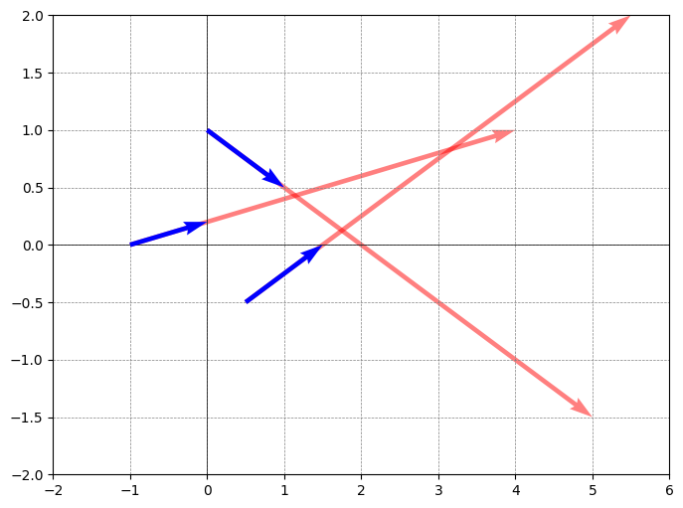
AN Primitive - Intersecting Vectors Technique

